Slide 1
Lecture 13 Complex Tasks: Workflow Design
Chien-Ju (CJ) Ho

Slide 2
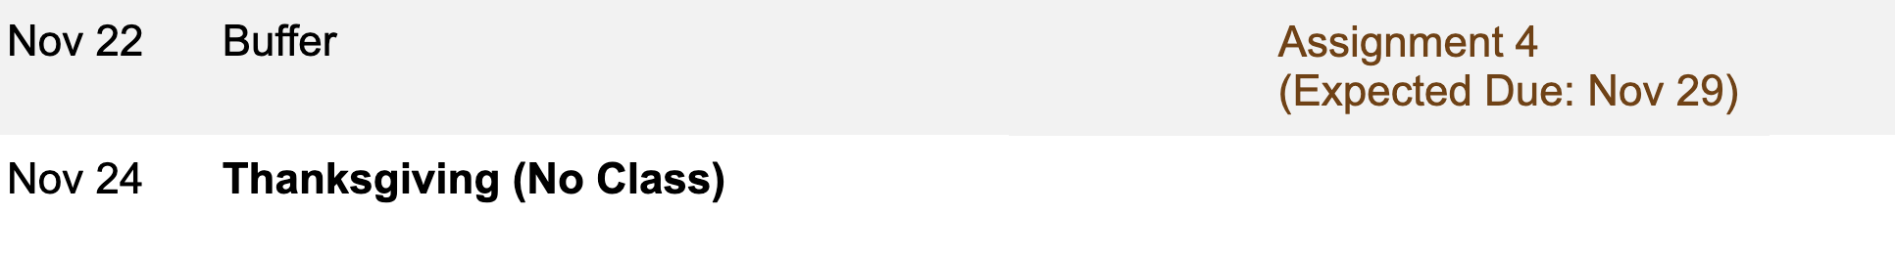
Logistics: Assignments
Assignment 3: Due yesterday
Assume you have enough late days, tomorrow is the final due
Assignment 4: TBD

Slide 3
Logistics: Project Milestone 2
Milestone 2: Due Nov 4
Summarize your progress
Should make enough progress to know whether the project is feasible
Last chance to convert a research project to an extensive literature survey
Midterm Pitch: Nov 1 (Tue), in lecture
Opportunity to engage other classmates
Every group will get some time from other groups
If you want to engage the entire class (for data collection, etc)
Let me know at least one week in advance
There might be time limits (e.g., 2~3 minutes)
Plan your progress to utilize this discussion lecture

Slide 4
Logistics: Class Participation
A reminder of the requirement we emphasized in the first lecture.
Participation is important for this course
I plan to enforce the participation requirement
A non-linear grading scheme
Most students will either get full credits or 0 credits for participation.
Examples:
Attend every lecture but rarely participate in discussion: 0 credits for participation
Attend less than 60~70% of the lectures: 0 credits for participation

Slide 5
Complex Tasks: Workflow Design

Slide 6
Crowdsourcing
A lot of focuses are on microtasks
Labeling images
Transcribing a one-minute audio clips
Finding the address of a business
…
A common quality control mechanism
Duplicate tasks and perform aggregation
Design incentives

Slide 7
What about Complex Tasks?

Slide 8
Designing Workflows
Dictionary definition of workflow
“the sequence of steps involved in moving from the beginning to the end of a working process”
Decompose a complex task into a set of microtasks
Some workers are asked to perform improvement tasks
Some workers are asked to vote on whether the improvement is good
Little et al. “TurKit: Tools for Iterative Tasks on Mechanical Turk”. HCOMP 2009

Slide 9
Designing Workflows
Little et al. “TurKit: Tools for Iterative Tasks on Mechanical Turk”. HCOMP 2009
Notes:
Yellow: improvements made by workers across versions
Blue: wrong
(): workers are uncertain

Slide 10
Other Workflows
Calculate nutrition values of a food photo [Noronha et al. UIST 2011]
Proofreading and document editing [Bernstein et al. UIST 2010]
Extracting steps from how-to videos [Kim et al. CHI 2014]
Tag – Identify - Measure
Find – Fix - Verify
Find – Verify – Expand

Slide 11
Another Approach [Focus of Next Lecture]
We can recruit experts in doing the work
Traditional workplace approach
There exist such crowdsourcing marketplaces as well (e.g., Upwork or Fiverr)

Slide 12
Designing Workflows
Treating humans as computation units
Question:
Can we incorporate humans in the computational framework?
Can we implement human computation as function calls?
We are simultaneously collecting data from humans to train AI/ML.
May gradually replace human computation function calls with automatic process when AI/ML catches up.

Slide 13
TurKit: Human Computation Algorithms
Little et al. UIST 2010

Slide 14
Example: Iterative Writing
Task: Have workers iteratively refine the description for the image.

Slide 15
Example: Iterative Writing
Task: Have workers iteratively refine the description for the image.

Slide 18
Human Computation Algorithms
Key Properties:
Human computation costs more than machine computation
Web applications are generally prone to errors
Goal: Design a robust algorithmic framework for human computation algorithms

Slide 19
Crash-and-Rerun Programming
Intuitions:
Store the results of human computation function calls to database (DB).
If error happens, crash the program and rerun from the start
For costly operations, obtain results from the DB instead of running it
Implementation: introduce keyword once
Remove non-determinism
Store costly operations
Provide functionalities
prompt, vote, sort
fork, join
work with MTurk APIs

Slide 20
Performance Evaluation
The paper demonstrates the results for a couple of applications.
They also measure the time for completion for 1-cent HITs.
Can we reduce the latency?
Real-time crowdsourcing

Slide 21
Other Frameworks
AutoMan
https://emeryberger.com/research/automan/
Developed by the team at UMass Amherst
Provide support for quality and budget control
TurkServer
https://github.com/TurkServer
Support multi-worker collaborations

Slide 22
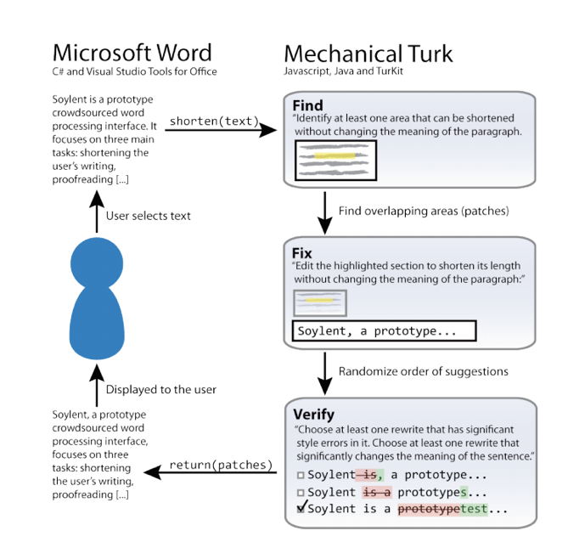
We can write workflows with TurKit, however…
Workflow design is domain specific and requires a great amount of effort

Slide 23

The Ultimate Goal
How many calories does the food in the photo contains?

Slide 24
Can we utilize the crowd to design workflows…
Can we utilize AI to help design workflows…

Slide 25
Discussion
What’s your general thoughts on TurKit? What additional functionalities do you hope they also provide?
We usually use time and space complexity to characterize how good an algorithm. Imagine you are now trying to develop a similar theory for human computation algorithms, what do you think are the key factors that should be considered?
How can we utilize the crowd to design workflows?
Assume we require each worker can only do microtasks worth less than 20 cents

Slide 26
Turkomatic: A workflow for designing workflows
Kulkarni, Can, and Hartmann. CSCW 2012.

Slide 27
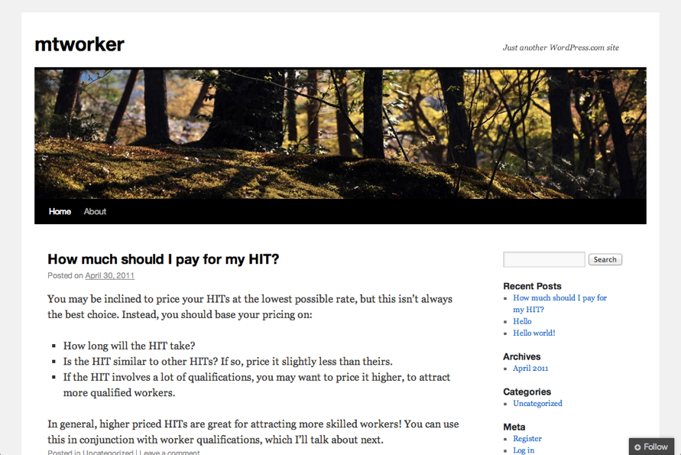
Example Task
Create a new blog about Mechanical Turk with two posts.

Slide 28
Price-Divide-Solve
A divide-and-conquer workflow
Price: Can this task be solved for 20 cents
If yes: Solve the task and return the answer
If no: Divide the task into multiple steps
For each step, start from the price step
Merge steps into solutions

Slide 29
Price-Divide-Solve
A divide-and-conquer workflow
Price: Can this task be solved for 20 cents
If yes: Solve the task and return the answer
If no: Divide the task into multiple steps
For each step, start from the price step
Merge steps into solutions

Slide 30
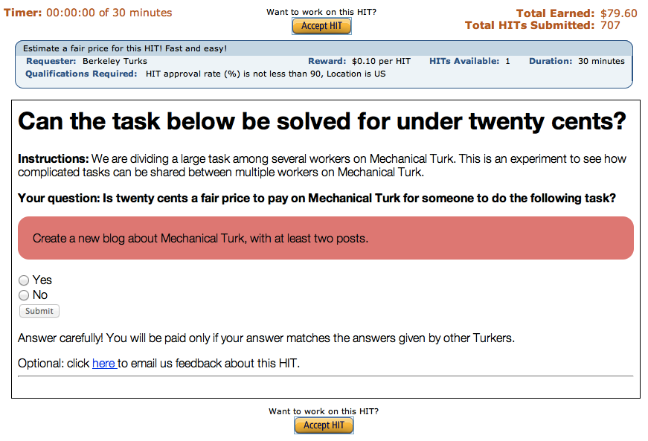
Create a new blog about Mechanical Turk with two posts.
Price
Can we solve it for 20 cents?
No.
Can this task be solved for 20 cents?
Write a blog about Mechanical Turk
Yes
No
Submit

Slide 31
Create a new blog about Mechanical Turk with two posts.
Divide
Divide it into two or more steps.
Break down the following task.
Write a blog about Mechanical Turk
Step 1:
Step 2:
Add Step
Submit

Slide 32
Create a new blog about Mechanical Turk with two posts.
Divide
Divide it into two or more steps.
Create a new blog on Wordpress.com.
Write one entry for a blog.
Write a second entry for a blog.

Slide 33
Create a new blog about Mechanical Turk with two posts.
Price
Create a new blog on Wordpress.com.
Write one entry for a blog.
Write a second entry for a blog.
Can we solve it for 20 cents?
Can we solve it for 20 cents?
Can we solve it for 20 cents?
Yes.
Yes.
Yes.

Slide 34
Create a new blog about Mechanical Turk with two posts.
Solve
Create a new blog on Wordpress.com.
Solve the following task.
Write a second entry for a blog.
Write one entry for a blog.
Create a new blank blog on Wordpress
Can we solve it for 20 cents?
Can we solve it for 20 cents?
Can we solve it for 20 cents?
Yes.
Yes.
Yes.
Submit

Slide 35
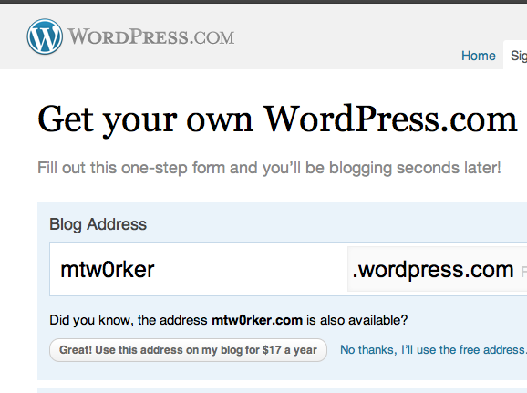
Create a new blog about Mechanical Turk with two posts.
Solve
Create a new blog on Wordpress.com.
Write one entry for a blog.
Write a second entry for a blog.
“You may be inclined to price your HITs at the lowest possible rate, but this isn’t always the best choice. Instead, you should base your pricing on:
-How long will the HIT take?
-Is the HIT similar to other HITs? If so, price it slightly less than theirs.
-If the HIT involves a lot of qualifications, you may want to price it higher, to attract more qualified workers.”
“Welcome to my blog about Mechanical Turk! Here, I’ll be posting some of my favorite recipes for Mechanical Turk. You’ll be able to follow along at home and create delicious HITs. From the comfort of your own home! Stay tuned and i’ll show you some of the best strategies for keeping your Turk workers engaged.”

Slide 36
Create a new blog about Mechanical Turk with two posts.
Merge
Combine the results of solved steps.
Create a new blog on Wordpress.com.
Write one entry for a blog.
Write a second entry for a blog.
Merge the following subtasks.
Write a blog about Mechanical Turk
Workers previously divided this task into simpler steps and solved each step. Combine their work into a complete solution.
Step 1:
Create a blank blog about Mechanical Turk [answer: www...]
Step 2:
Write a blog post about Mechanical Turk. [answer: This post is…]
mtworker.wordpress.com
Submit

Slide 37


Slide 38

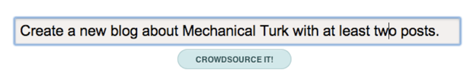


Price
Divide
Solve
Requester Interface
Algorithm
System Output
Worker Interface

Slide 39
Short Discussion
Can you come up with scenarios/situations that this approach might fail? What are the potential fixes?
Price
Divide
Solve
Requester Interface
Algorithm
System Output
Worker Interface

Slide 40

Using Majority Vote to Ensure Quality
Divide Task
Best subdivision
Price Task
Price Task
Vote
Price check
Consensus on price
Price Task
Price Task
Majority
Solve Task
Best solution
Price Task
Price Task
Vote

Slide 41
Success Experiment
Write a 3-paragraph essay about whether it’s ever OK to lie.
Write one paragraph arguing it’s OK to lie sometimes.
Write one paragraph suggesting it’s never OK to lie.
Write a conclusion reconciling the two.
Write one sentence to open the conclusion.
Write 2-3 sentences in the middle of the conclusion.
Write a concluding sentence.

Slide 42
Failed Experiment 1
Plan a trip from New York to S.F. that visits 5 interesting places.
Think about where to go next in Ohio.
Think about where to go next in Ohio.
Failing to Terminate

Slide 43
Failed Experiment 2
List the department chairs of the top 20 US programs in CS.
Turkomatic worker:
“…I’ve taken a look at your instructions, and I understand them perfectly. However, this task seems to have been inadvertently sabotaged by other turkers who do not understand what you are asking them to do…”
aalto armchair
poang lounge chair
adirondack chair
aeron chair
balans chair
ball chair
….
Early mistakes propagate

Slide 44
Proposed Fixes
Utilizing more skilled workers
The experiments using graduate students as workers are all successful
Including requester interventions
Designing visualizations, and enable requesters to modify the workflow on the fly

Slide 45
Proposed Fixes
Utilizing more skilled workers
The experiments using graduate students as workers are all successful
Including requester interventions
Designing visualizations, and enable requesters to modify the workflow on the fly
Allow requesters to provide seed workflows

Slide 46
AI-Assisted Workflow Design
(utilizing AI to help tune the parameters of workflow)
Decision-theoretic Control of Crowd-sourced Workflows.
Peng Dai, Christopher H. Lin, Mausam, Daniel S. Weld. AI Journal 2013.

Slide 47
Example
Decisions to make at each step
Should we keep voting?
Should we create an improvement task?
Should we terminate the process and output the results?
This is a sequential decision-making problem under uncertainty.

Slide 48
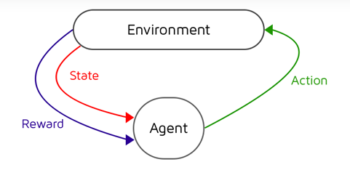
Markov Decision Process
Markov decision process (MDP)
Partial observable Markov decision process (POMDP)
State is not directly observable,
We can observe some output/signals depending on the state
(think about problem 2 of assignment 3)
Require additional reasoning
Main components
States (of the environment)
Action
State transitions
Rewards

Slide 49
TurKontrol
POMDP formulation
Actions = {vote, improve, terminate}
State = {(q, q’)} (q: the original quality of the article, q’ the improved one)
State transition, observation, rewards are defined w.r.t. to the inference

Slide 50
Improvements over Fixed Parameters

Slide 51
Discussion
General thoughts on the two approaches
Utilizing the crowd to design workflows
Utilizing AI to design workflows
These approaches are obviously not perfect yet. What are the other aspects of workflow design we can utilize AI/crowd to help? How?

Slide 52
Can we use the idea of workflows in our daily tasks?

Slide 53
Selfsourcing Personal Tasks
Teevan, Liebling, and Lasecki. CHI WiP 2014.

Slide 54
How long can you continuously focus on work?
before being interrupted by
checking emails
checking Facebook/Instagram/Twitter
…
Notes:
Although we think complex information work requires a large, uninterrupted chunk of time to complete, we almost never actually have a solid block time in which to get things done.
Research shows it takes 25 minutes to reach full productivity after an interruption, yet we are interrupted every 11 minutes. Never working at full productivity.
Even without external interruptions, our focus is fragmented.
We look at any given desktop window an average of only 20 seconds, constantly self-interrupting to check email or Facebook.
We also try to complete multiple tasks at once, despite the fact that we all know multitasking produces worse outcomes than doing tasks serially.
Our tendency to be easily distracted kept our hunter and gatherer ancestors alive when they needed to attend to potential predators.
But now, in the safety of our offices, it is amazing we get anything done.
Many of the chunks of time we have in a day are too short to bother trying to use productively.
Think of the time you spend waiting for a meeting to start, riding in an elevator, or standing in line.
Yet these micromoments add up.
People spend 200 million minutes a day on Angry Birds alone.
If we could leverage the small mobile bursts of effort that Angry Birds players currently spend killing time, it would only take 18 days to release the equivalent of Microsoft Office.

Slide 55
Microproductivity: Designing Workflows for Yourself
Task Structure – Break tasks into microtasks
What we know: Examples of many complex tasks can be broken down
Still needed: What tasks can be broken down? How to capture context?
Task Completion – Make it easy to do microtasks
What we know: Microtasking is easier, especially when mobile
Still needed: When to break tasks down? How to prioritize microtasks?
Task Sharing – Get microtasks to the right person
What we know: Reduce collaboration overhead with colleagues, crowd
Still needed: Who is the best person to do a microtask?
Task Automation – Learn microtasks via hybrid intelligence
What we know: Possible to incorporate automation into workflows
Still needed: When can AI systems benefit from human input?

Slide 56
Example: Article Writing
Slides from Jaime Teevan

Slide 57
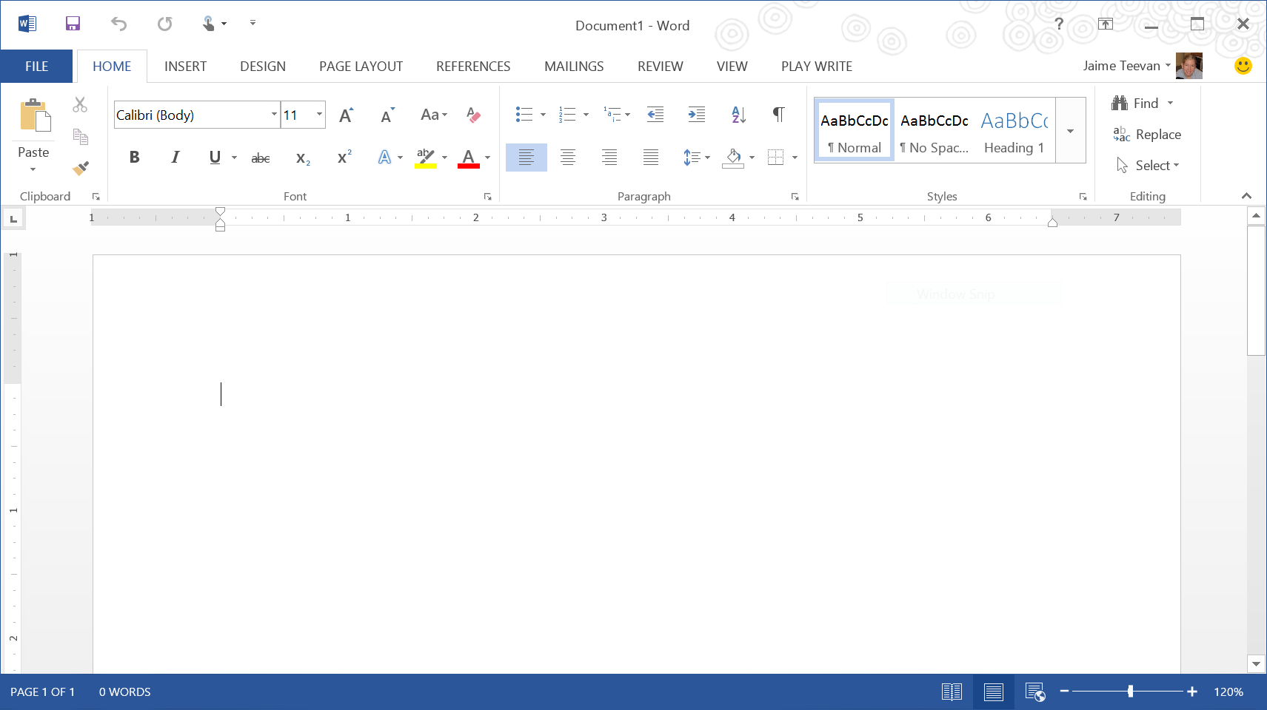
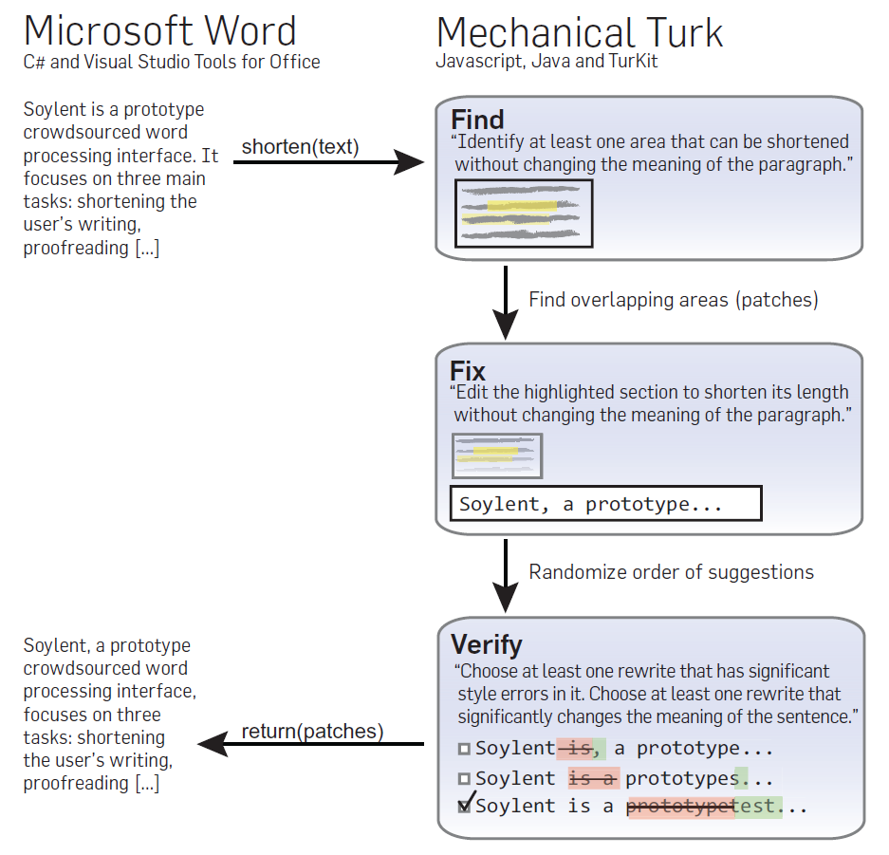
Notes:
You are probably familiar with this challenge: A blank Word document.

Slide 58
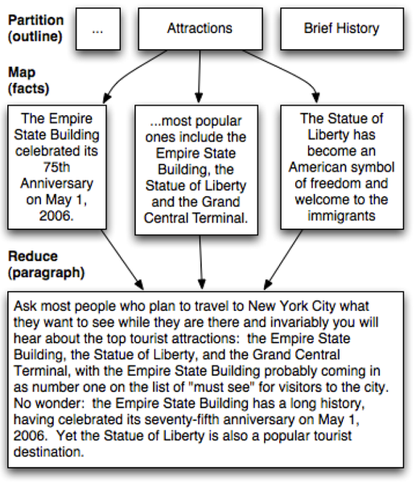
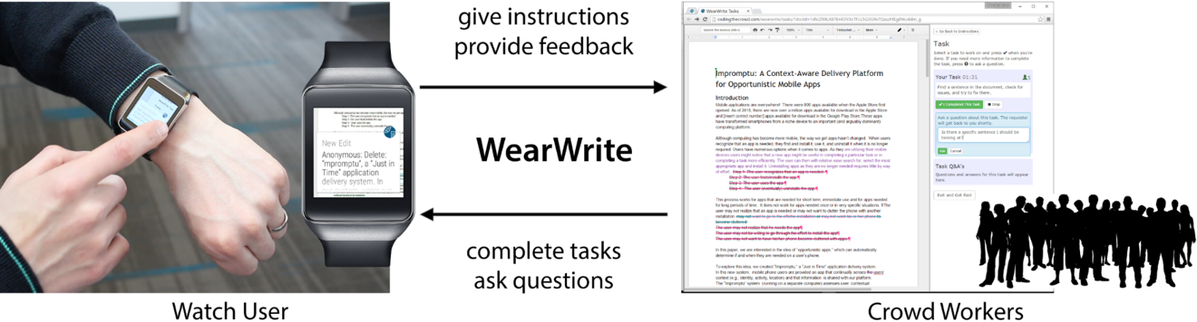
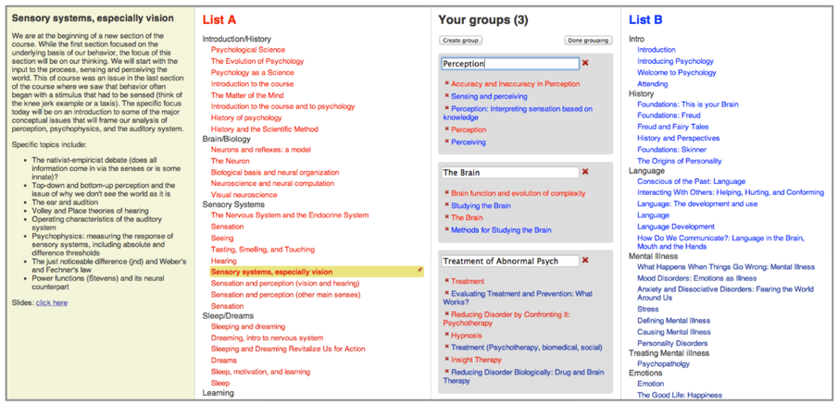
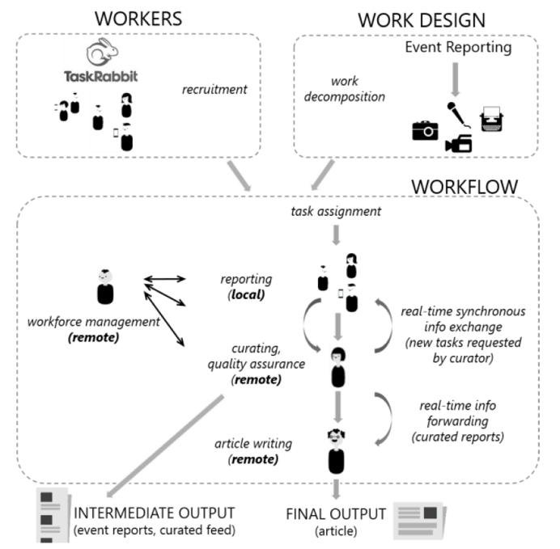
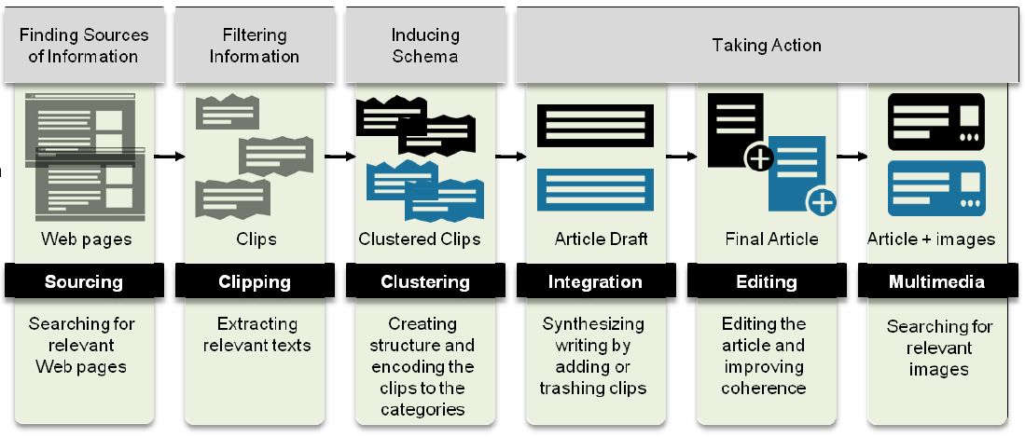
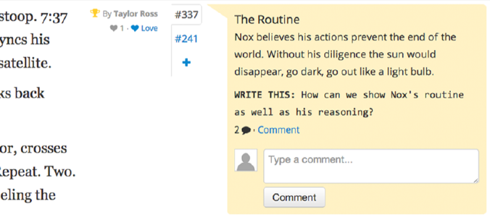
Nebeling, To, Guo, de Freitas, Teevan, Dow & Bigham. WearWrite: Crowd-assisted writing from smartwatches. CHI 2016.
Kittur, Smus, Khamkar & Kraut. CrowdForge: Crowdsourcing complex work. UIST 2011.
Luther, Hahn, Dow & Kittur. Crowdlines: Supporting Synthesis of Diverse Information Sources through Crowdsourced Outlines. HCOMP 2015.
Bernstein, Little, Miller, Hartmann, Ackerman, Karger, Crowell & Panovich. Soylent: A word processor with a crowd inside. UIST 2010.
Hahn, Chang, Kim & Kittur. The Knowledge Accelerator: Big picture thinking in small pieces. CHI 2016.
Agapie, Teevan & Monroy-Hernández. Crowdsourcing in the field: A case study using local crowds for event reporting. HCOMP 2015.
Kim, Cheng & Bernstein. Ensemble: Exploring complementary strengths of leaders and crowds in creative collaboration. CSCW 2014.

Slide 59
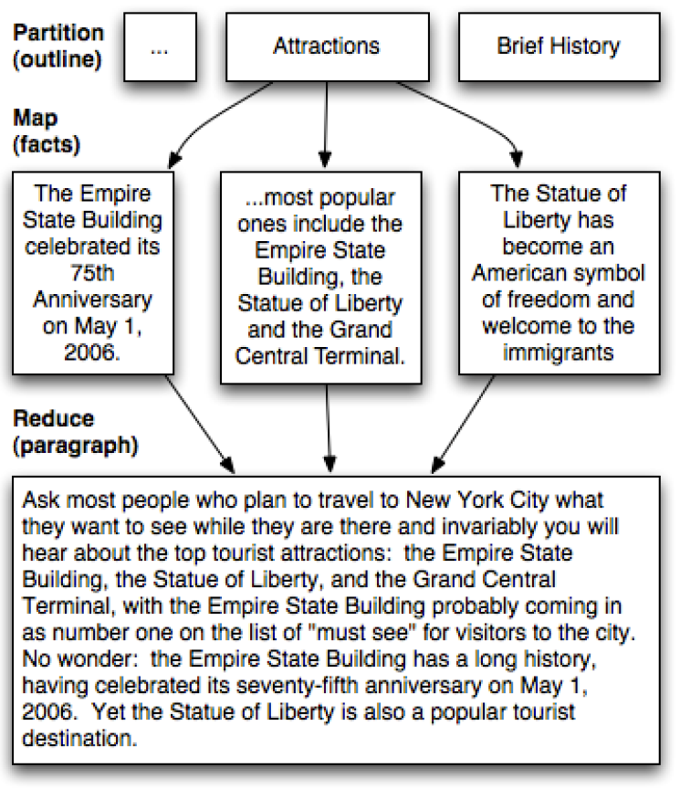
②
① Collect content
② Organize content
③ Turn content into writing
①
③
Notes:
Collecting content: Short data gathering tasks are useful for ideation while writing (Eventful for local event tidbits, CrowdForge for facts, Mining Memories uses tweets).

Slide 60
① Collect Content
The MicroWriter breaks writing into microtasks
Microtasks can be shared with collaborators
Microtasks can be done while mobile
Collaborative writing typically requires coordination
Collaborators can be known or crowd workers
People have spare time when mobile
Structure turns big tasks into series of small microtasks
Microtasks make it easy to get started

Slide 61
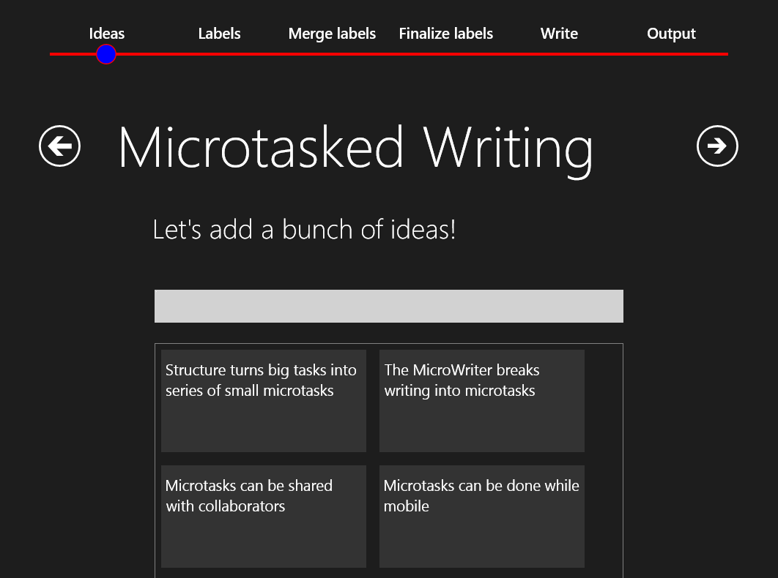
① Collect Content
Notes:
Reflect back pre-existing ideas, because these are shown to encourage brainstorming.

Slide 62

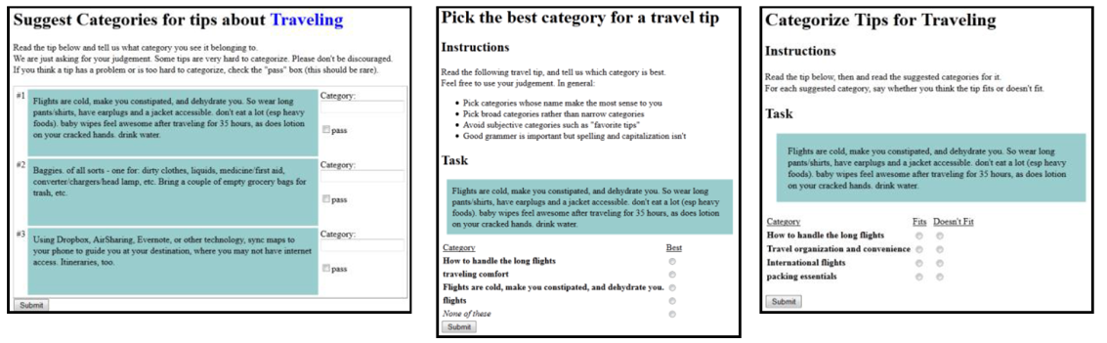
②
① Collect content
② Organize content
③ Turn content into writing
①
③
①
Notes:
Organizing content: Often handled top-down and thus typically is done first (e.g., CrowdForge) or requires a “leader” with a big picture view (e.g., Ensemble). But individuals often know the content they want to write even without a structure in mind, so we allow the structure to emerge from the content inspired by the Cascade approach for organizing content into a hierarchy.

Slide 63
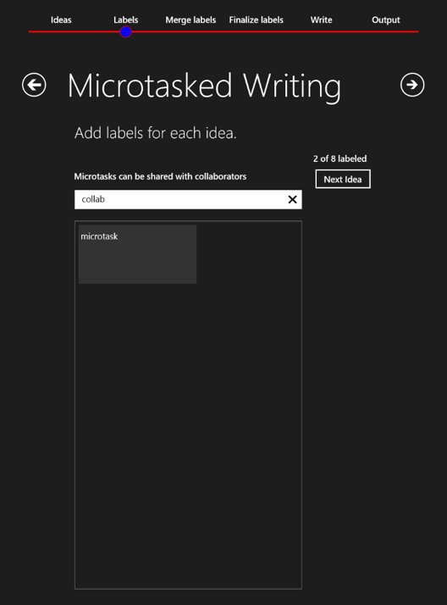
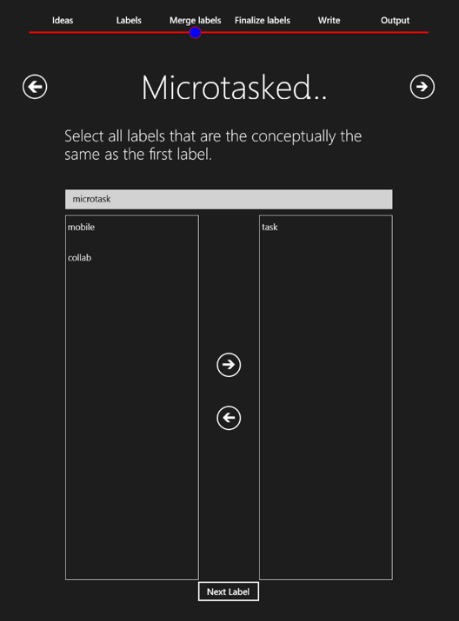
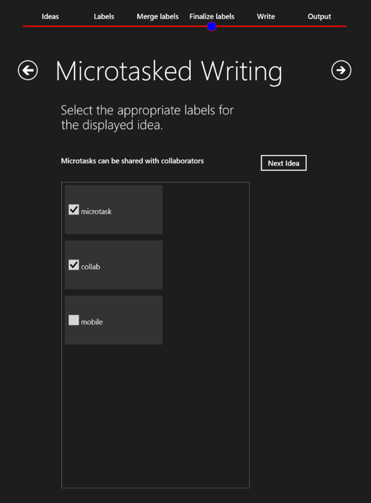

② Organize Content

Slide 64
② Organize Content
collab
Microtasks can be shared with collaborators
microtask
tasks
mobile

Slide 65
② Organize Content
The MicroWriter breaks writing into microtasks
collab
Microtasks can be shared with collaborators
Microtasks can be done while mobile
microtask
Collaborative writing typically requires coordination
mobile
Collaborators can be known or crowd workers
People have spare time when mobile
Structure turns big tasks into series of small microtasks
Microtasks make it easy to get started

Slide 66
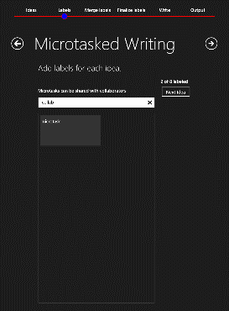
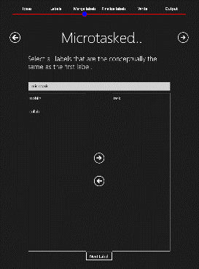
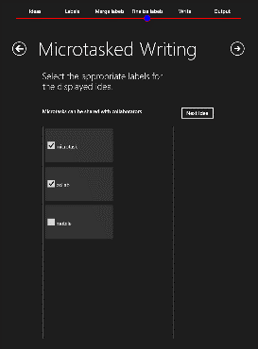
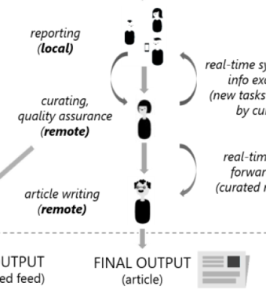

②
① Collect content
② Organize content
③ Turn content into writing
①
③
①
②
①
②
③

Slide 67
③ Turn Content into Writing
The MicroWriter breaks writing into microtasks
②
collab
Microtasks can be shared with collaborators
Microtasks can be done while mobile
①
microtask
Collaborative writing typically requires coordination
③
mobile
Collaborators can be known or crowd workers
People have spare time when mobile
Structure turns big tasks into series of small microtasks
Microtasks make it easy to get started

Slide 68
③ Turn Content into Writing
Microd
The MicroWriter breaks writing into microtasks
Structure turns big tasks into series of small microtasks
Microtasks make it easy to get started
Collab
Microtasks can be shared with collaborators
Collaborative writing typically requires coordination
Collaborators can be known or crowd workers
Mobile
Microtasks can be done while mobile
People have spare time when mobile
microtask
collab
mobile

Slide 69
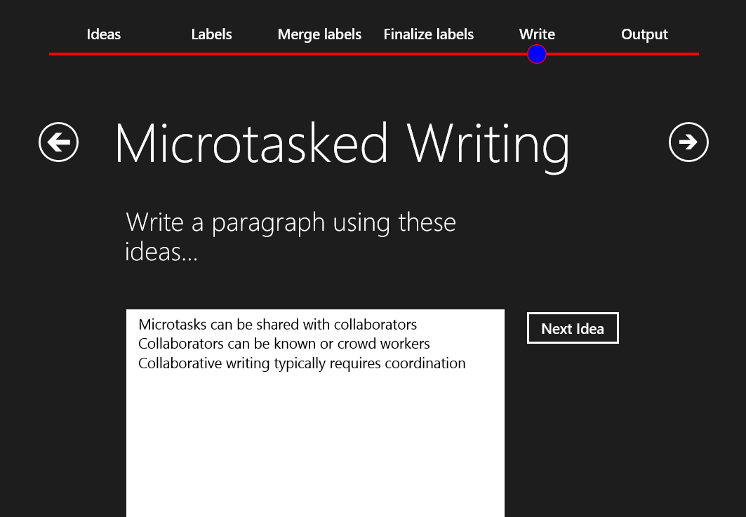
③ Turn Content into Writing

Slide 70
③ Turn Content into Writing
Micro
Microtasks can be shared with collaborators
Collaborative writing typically requires coordination
Collaborators can be known or crowd workers
collab
Collaborative writing typically requires coordination. However, microtasks are easy to share with collaborators without the need for coordination. The collaborators can be known colleagues, or paid crowd workers.

Slide 71
③ Turn Content into Writing
Complete output:
Structure makes it possible to turn big tasks into a series of smaller microtasks. For example, the MicroWriter breaks writing into microtasks. These microtasks make the larger task easier to start.
Collaborative writing typically requires coordination. However, microtasks are easy to share with collaborators without the need for coordination. The collaborators can be known colleagues, or paid crowd workers.
People have spare time when mobile, and these micromoments are ideal for doing microtasks.

Slide 72

②
① Collect content
② Organize content
③ Turn content into writing
①
③
MicroWriter
①
②
③
Notes:
Could then clean up the content a la Soylent.

Slide 73
Microproductivity: Designing Workflows for Yourself
Task Structure – Break tasks into microtasks
What we know: Examples of many complex tasks can be broken down
Still needed: What tasks can be broken down? How to capture context?
Task Completion – Make it easy to do microtasks
What we know: Microtasking is easier, especially when mobile
Still needed: When to break tasks down? How to prioritize microtasks?
Task Sharing – Get microtasks to the right person
What we know: Reduce collaboration overhead with colleagues, crowd
Still needed: Who is the best person to do a microtask?
Task Automation – Learn microtasks via hybrid intelligence
What we know: Possible to incorporate automation into workflows
Still needed: When can AI systems benefit from human input?

Slide 74
Discussion
What tasks in your life do you think that might benefit through adopting microproductivity?
How should you decompose the task? Can you share some of the microtasks? Can you automate some of the microtasks?

